Slide 1
Classification (January 2022)
Metis – Data Science Flex Module 4

Slide 2

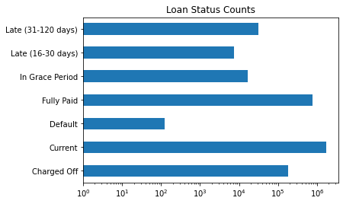
Target Feature: ‘loan_status’: [Current; Fully Paid;
Charged Off; Late (31-120 days); In Grace Period; Late (16-30 days); Default]
Assumptions:
Any loan that isn’t late is considered current, will be repaid in full, and will pay interest during the entire life of the loan
Any loan that is late is considered in default immediately with no interest paid and all money lost
Business Problem: Predict whether a P2P personal loan will be delinquent and use the analysis to recommend investments for retail investors.
 | Raw Data | Final Data Set
Columns | 195 | 19 (including classification target)
Rows | 2.7MM | 840k+
*Personal Loans originated by Lending Club from 2008 - 2019

Slide 3
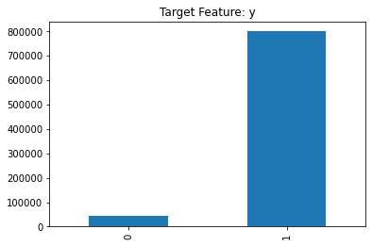
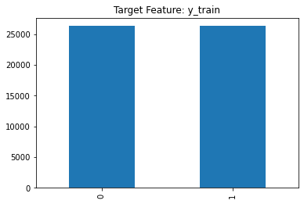
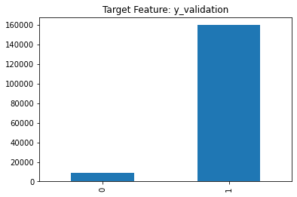
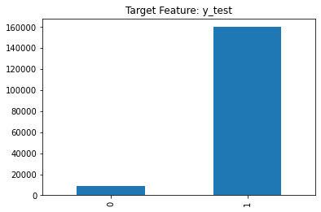
Data Set - Overview
**The average default rate for personal loans is 2.5%, as of 2021.
60%
20%
Default: 44,178** / Current: 800,173
20%
Default: 26,306 / Current: 26,306
Default: 9,002 / Current: 159,868
Default: 8,870 / Current: 160,001

Slide 4
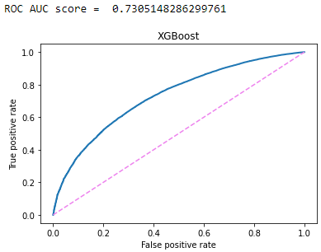
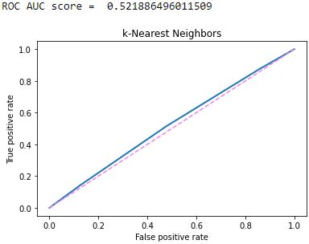
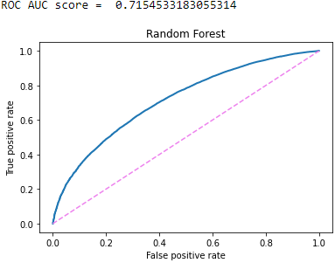
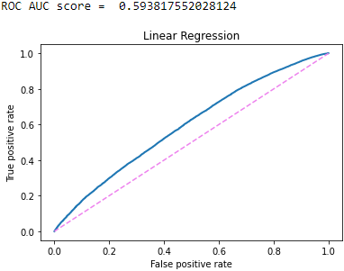
Fitting & Scoring Models

Slide 5
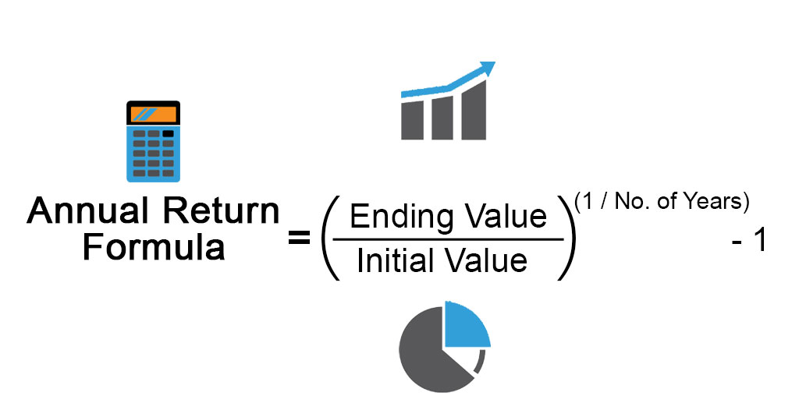


Analysis – Measuring Success with ARR
Initial Loan Investment + Interest Income – Defaulted Loans
Initial Loan Investment

Slide 6
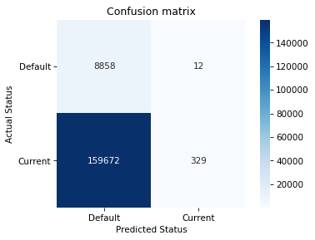


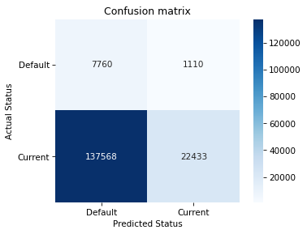

Analysis – Measuring Success with ARR
LogReg – Threshold: 0.89
XGBoost – Threshold: 0.99
kNN – Threshold: 0.90
Random F. – Threshold: 0.90

Slide 7
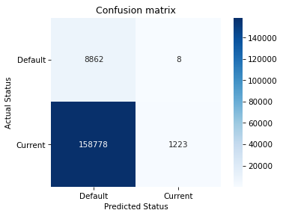
Analysis – Measuring Success with ARR
Model A
Model B

Slide 8

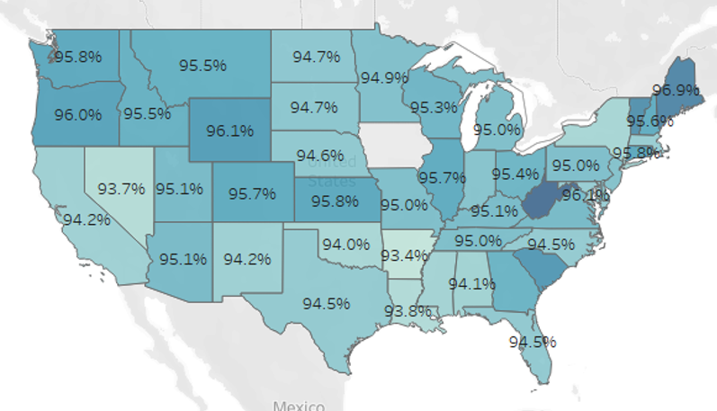
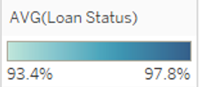
Looking Forward (Micro vs. Macro)
Model out specific loans from data set that are predicted to perform well
Choose individual loans and calculate with a more nuanced ARR model
Minimize default rates, the delinquency rate (60 days or more past due) is 2.5%
Lower default rates concentrated in the NE and NW of the United States.
Is this reflective of economic conditions?
Using loan credit risk to narrate macroeconomic trends

Slide 9
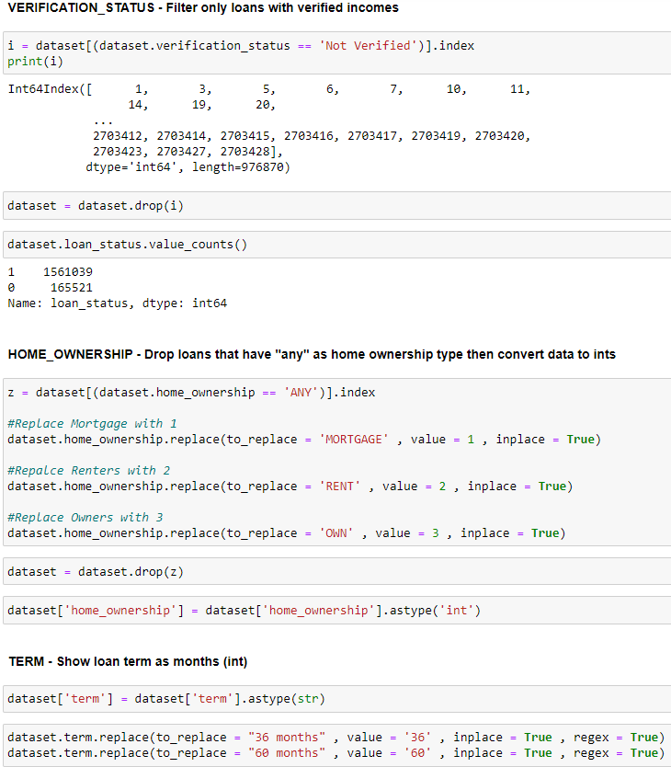
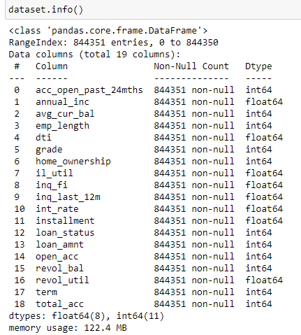
Appendix – Feature List and EDA

Slide 10
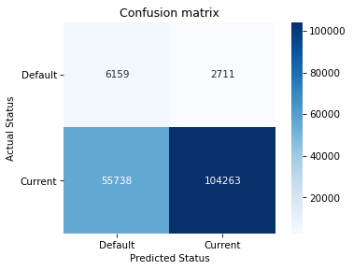



XGBoost Model
Appendix – XGBoost Scores
Hyperparameter tuning and before/after scores:
Before
After
Final Scores

